Slide 1
Aspects of Immigration
By: Tonya Bunch, Benita Dowdell, Ashlyn Hodges, Lauren Penley, Corina Relyea, and Lecretia Williamson

Slide 2
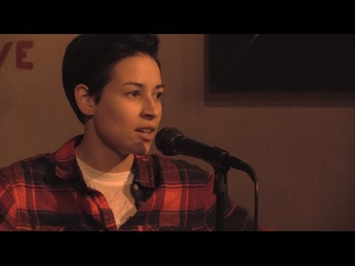
“Borders”

Slide 3
What is Immigration?
Immigration is the international movement of people into a destination country of which they are not natives or where they do not possess citizenship in order to settle or reside there, especially as permanent residents or naturalized citizens, or to take up employment as a migrant worker or temporarily as a foreign worker.

Slide 4
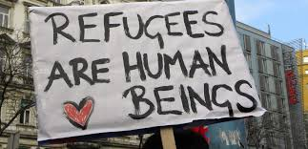
Refugee
a person who has been forced to leave their country in order to escape war, persecution, or natural disaster.
According to the Center for New North Carolinians, Guilford County becomes home to an average of nearly 700 new refugees each year. (About NCASC, 2018)
Under United States law, a refugee is someone who:
Is located outside of the United States
Is of special humanitarian concern to the United States
Demonstrates that they were persecuted or fear persecution due to race, religion, nationality, political opinion, or membership in a particular social group
(Refugees, 2017)
Is not firmly resettled in another country
Is admissible to the United States
What does it look like…..
The Process
Coming to the United States
Bring Family
Working in the U.S
Filing for Permanent Residency (Green Card)
Traveling Abroad
(Refugees, 2017)

Slide 5
Guilford County’s Recent Arrivals
Groups from
Somalia
Myanmar (formerly Burma)
Sudan
Eritrea
Ethiopia
Vietnam
Cuba
Bhutan and Nepal
Burundi
The Democratic Republic of Congo
Rwanda
Iraq
Pakistan
Syria
Afghanistan

Slide 6
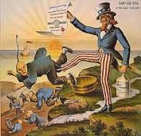
Native Views on Refugees
Fears
  What fears could someone have about individuals with immigrant/refugee status?
  Xenophobia- intense or irrational dislike or fear of people from other countries.
  American Safe Act
    bipartisan, veto-proof majority vote
    It requires a higher level of verification for a refugee from Syria or Iraq to be allowed into the country. (Ryan, 2015)
  African and Non-African Refugees' Perceptions of Police: A Study of Two American Cities
  When Hate Comes to Town: Community Response to Violence Against Immigrants

Slide 7

TanLe’s
Story
Fled Vietnam at four years old
Family left by boat concealed as a fishing boat
Landed in a refugee camp for 3 months
Settled in Australia
Became “typical” Asian student
Scholarship to Law School
Moved to San Francisco, California

Slide 8
Vietnamese and East Timorese Refugees and Depression
Escaped from trauma, war and persecution.
While escaping by boat they faced extortion, robbery, murder, rape, piracy, thirst, and starvation
Refugee camps; leaving family behind
Presenting issues and language
Important to hear their story from escaping
  Their experience of refugee camps and placement in another country
Validating their feelings and experiences
Understanding the time for readjustment from relocating

Slide 9
Montagnard Refugees
By 2005 about 5000 live in North Carolina
Fled their homeland
Families were placed separately and had to wait for wives and children for years
They continue to have an emotional and relational sense for their people in Vietnam
Home is part of an identity
Acculturating to the host community while trying to maintain some cultural traditions
Are disadvantaged because of their race, class, and gender
Social workers need to address location, education, and learning English

Slide 10
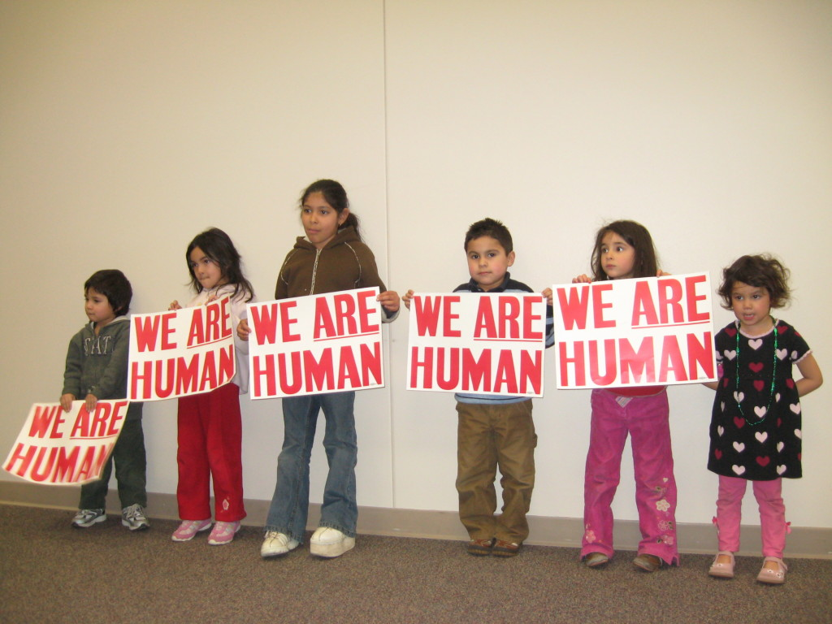
Impact of Immigration on Children
Many immigrant children perceive that Americans do not welcome them and that they do not deserve to participate in the “American Dream”.
This rejection has psychological costs: shame, doubt, and even self-hatred.
( Suarez-Orozco, 2015 )

Slide 11
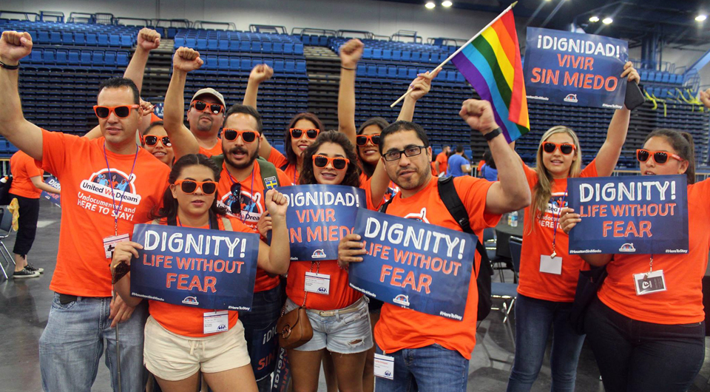
Acculturation and Immigrant Children
While some are able to join integrated well-to-do neighborhoods, the majority of today’s immigrants come to experience American culture from the vantage point of poor urban settings. Limited economic opportunities, toxic schools, ethnic tensions, violence, drugs. (Suarez-Orozco, 2015 )

Slide 12
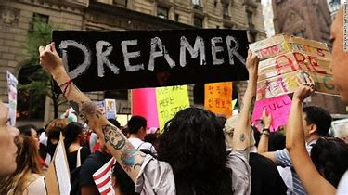
The Deferred Action for Childhood Arrivals (DACA)
Deferred Action for Childhood Arrivals (DACA) is a kind of administrative relief from deportation. The purpose of DACA is to protect eligible immigrant youth who came to the United States when they were children from deportation. DACA gives young undocumented immigrants: 1) protection from deportation, and 2) a work permit. The program expires after two years, subject to renewal.

Slide 13
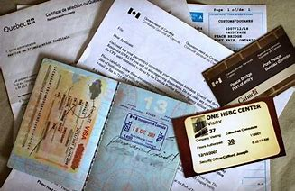
UNDOCUMENTED IMMIGRANT
An Undocumented Immigrant is a foreign-born person who lacks a right to be in the United States, having either entered without inspection (and not subsequently obtained any right to remain) or stayed beyond the expiration date of a visa or other status. Undocumented Immigrants are subject to deportation if apprehended.

Slide 14
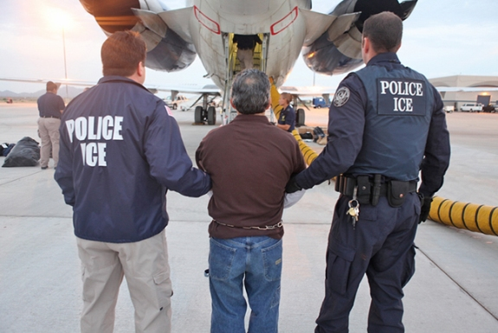
DEPORTATION
The transfer of an alien, by exclusion or expulsion, from the United States to a foreign country. The removal or sending back of an alien to the country from which he or she came because his or her presence is deemed inconsistent with the public welfare, and without any punishment being imposed or contemplated.

Slide 15
STEPS FOR DEPORTATION
Arrest by local police or US Border Patrol
Turned over to ICE Agent (Immigration and Customs Enforcement)
Expedited Removal
Notice to Appear
Detainment
Voluntary Departure
Bond Hearing
Master Calendar Hearing
Merits Hearing
Order of Removal
Appeal

Slide 16

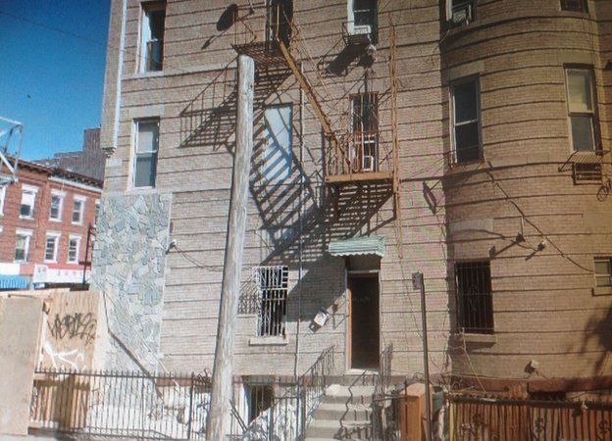
My life as a sex-trafficking victim: Shandra W. (BBC News)

Slide 17
Human/Sex Trafficking Statistics
Trafficking women and children for sexual exploitation is the fastest growing criminal enterprise in the world.
At least 20.9 million adults and children are bought and sold worldwide into commercial sexual servitude, forced labor and bonded labor.
About 2 million children are exploited every year in the global commercial sex trade.
54% of trafficking victims are trafficked for sexual exploitation.
Women and girls make up 96% of victims of trafficking for sexual exploitation.
The Sex trafficking industry is making an estimated $99 billion a year.
75% of victims are undocumented immigrants

Slide 18
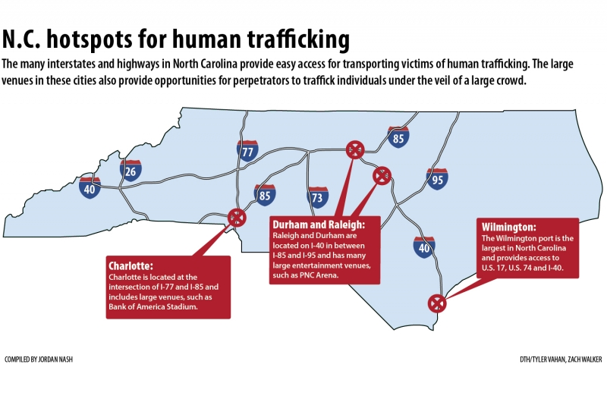

Slide 19
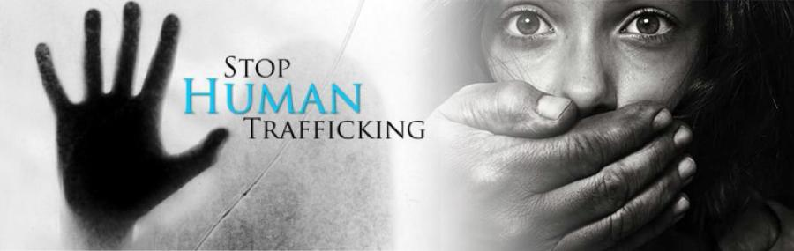
Immigration and Sex Trafficking: Recruitment Strategies and Vulnerable Populations
People are typically Trafficked in three main ways: born into slavery, kidnapped, sold, or physically forced, and tricked.
Extreme Poverty, more specifically, Immigrants in Poverty (75% of reported victims were undocumented immigrants)
Victims are lured from their homes with false promises of well-paying jobs
Seemingly legitimate organizations advertise employment, modeling, and marriage agencies to offer access to a better life in a richer nation.
Some victims are kidnapped or purchased from family members promising to give their daughters a better life in a richer nation.

Slide 20
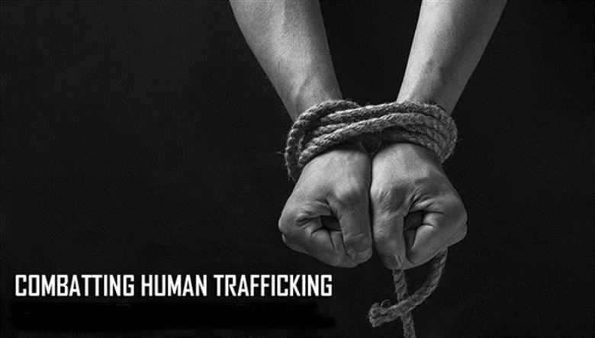
Aftercare Services For Survivors
Recommended Aftercare Services:
Basic necessities (food, clothing, etc.)
Secure, safe shelter and housing(immediate and long-term)
Physical health care and mental health care (crisis intervention, self-help groups, counseling, substance abuse treatment)
Legal and immigration advocacy
Life skills and job training
Child Care, Education, and Language services
Substance abuse services
Sex trafficking survivors suffer physical injuries and long-term psychological consequences.
NATIONAL HOTLINE:
1-888-373-3888 | BEFREE TEXTLINE: 233733 | WWW.POLARISPROJECT.ORG

Slide 21
Immigration on Social Media
Social media has a vital impact on the way people perceive immigrants
Misleading statements / Misstatements made by people in office
Cherry picking cases for news outlets
News outlets do not verify what is true or what is not
Assumption that immigrants are terrorist

Slide 22
Myths and Facts about Immigration
Myth 1
Undocumented immigrants do not pay taxes.
Fact
Undocumented immigrants pay billions of dollars in taxes each year (U.S. Chamber of Commerce, 2016).

Slide 23
Myths and Facts about Immigration
Myth 2
Immigrants come to the United States for welfare benefits.
Fact
Undocumented immigrants are not eligible for federal public benefit programs, and even documented immigrants face stringent eligibility restrictions (U.S. Chamber of Commerce, 2016).

Slide 24
Myths and Facts about Immigration
Myth 3
Immigrants are more likely to commit crimes than native-born Americans.
Facts
Immigration does not cause crime rates to rise, and immigrants are actually less likely to commit crimes or be behind bars than native-born Americans (U.S. Chamber of Commerce, 2016).

Slide 25
Myths and Facts about Immigration
Myth 4
Building a wall along the U.S.-Mexico border, and deporting all undocumented immigrants from the United States, would enhance national security.
Facts
A border wall and mass deportation would have little impact on security, while severely damaging the U.S. economy in the process (U.S. Chamber of Commerce, 2016).

Slide 26
President Trump’s Travel Ban
Executive Order 13,769
  banned the entry of nationals from Iraq, Iran, Sudan, Libya, Somalia, Syria, & Yemen
  Exec Order denied
Executive Order 13,780 “Revised Order”
  kept 90 day ban for 6 of the original countries, removed Iraq
  kept 120-day suspension of refugees, but removed indefinite ban on Syrian refugees
Revised Order is inapplicable to
  lawful permanent residents, valid visas effective on date of ORIGINAL order, refugees scheduled to travel before effective date of revised order (Barrow, 2018)

Slide 27
What to do as Social Workers
Educate others
Advocate
Know the facts
Resources
  World Relief-High Point
  CWS Greensboro
  FaithAction International House
WR Brochure

Slide 28
References
About NCASC. (2018, May 22). Retrieved from The North Carolina African Services Coalition : http://ascafrica.org/about-ncasc/
Barrow, J. L. (2018). Trump’s travel ban: Lawful but ill-advised. Harvard Journal of Law &
Public Policy, 41(2), 691-717.
Kinefuchi, E. (2010). Finding Home in Migration: Montagnard Refugees and Post-Migration
Identity. Journal of International & Intercultural Communication, 3(3), 228-248.
doi:10.1080/17513057.2010.487220

Slide 29
References
Kokanovic, R., May, C., Dowrick, C., Furler, J., Newton, D., & Gunn, J. (2010). Negotiations of
distress between East Timorese and Vietnamese refugees and their family doctors in
Melbourne. Sociology of Health & Illness, 32(4), 511-527.
doi:10.1111/j.1467-9566.2009.01228.x
Leda Dederich, ScoutSeven. Undocumented Student Program | University of California at Berkeley. n.d. 18 May 2018.
Logan, T.K., Walker, Robert., & Hunt, Gretchen. (2009). Understanding Human Trafficking in the United States. Trauma, Violence, & Abuse, 10(1), 3-30.doi: 10.1177/1524838008327262

Slide 30
References
Macy, Rebecca. J., & Johns, Natalie. (2011). Aftercare Services for International Sex Trafficking Survivors: Informing U.S. Service and Program Development in an Emerging Practice Area. Trauma, Violence, & Abuse, 12(2), 87-98. doi: 10.1177/1524838010390709
Refugees. (2017, October 24). Retrieved from U.S. Citizenship and Immigration Services: https://www.uscis.gov/humanitarian/refugees-asylum/refugees

Slide 31
References
Ryan, R. P. (2015, November 23). Paul Ryan: On refugees, balance compassion and safety. Retrieved from CNN: https://www.cnn.com/2015/11/23/opinions/ryan-syrian-refugees/index.html
Shandra Woworuntu: My life as a sex-trafficking victim. (2016, March 30). Retrieved May 17, 2018, from http://www.bbc.com/news/magazine-35846207

Slide 32
References
Suárez-Orozco, M. M. (2001). Global shifts: US immigration and the cultural impact of demographic change. Seismic shifts, 179-188.
Suárez-Orozco, M., & Suárez-Orozco, C. (2015). Children of immigration. The Phi Delta Kappan, 97(4), 8-14. Retrieved from http://www.jstor.org/stable/24579534
Tan Le: My immigration story. Ted Talks. (2012). From Youtube website,
https://www.youtube.com/watch?v=hCop3IGZH2o

Slide 33
References
U.S. Chamber of Commerce, (2016). Immigration myths and the facts. Labor, Immigration & Employment Benefits. https://www.uschamber.com/sites/default/files/documents/files/022851_mythsfacts_2016_report_final.pdf

